Slide 1


Computer Concepts 2018
Module 10
Databases
Copyright © 2019 Cengage. All rights reserved.

Slide 2
Module Contents
Section A: Database Basics
Section B: Database Tools
Section C: Database Design
Section D: SQL
Section E: Big Data

Slide 3
Section A: Database Basics
Operational and Analytical Databases
Database Models

Slide 4
Section A: Objectives
Describe the difference between an operational database and an analytical database
List seven activities associated with operational databases
Provide at least three examples of analytics applied to databases
Draw the data structure for a flat file and label each component
Draw ERDs and provide real-life examples of one-to-one, one-to-many, and many-to-many relationships
Diagram the data structure for hierarchical, graph, relational, multidimensional, and object database models

Slide 5
Operational and Analytical Databases (1 of 8)
An operational database is used to collect, modify, and maintain data on a daily basis
An analytical database is used to collect data that will be used for spotting trends that offer insights for tactical and strategic business decisions

Slide 6
Operational and Analytical Databases (2 of 8)
Operational Databases
  Operational databases are commonly part of an enterprise’s TPS, OLTP, CRM, SCM, or ERP information systems.
  They store data as it is collected from point-of-sale systems, customer loyalty programs, social media signups, and other transactions.
  The data is typically dynamic. It changes constantly and reflects up-to-the-minute information.

Slide 7
Operational and Analytical Databases (3 of 8)
Analytical Databases
  Analytical databases commonly hold historical data copied from one or more transaction processing systems.
  Unlike an operational database, the data in an analytical database is not being constantly updated. Therefore, it remains relatively static.
  Because the data is historical, the information that can be inferred is like a snapshot of a point in time.

Slide 8
Operational and Analytical Databases (4 of 8)
Operational databases perform the following:
  Collect and store data
  View data
  Find data
  Update data
  Organize data
  Distribute data
  Move or remove data

Slide 9
Operational and Analytical Databases (5 of 8)
Analytical databases store data that is used by corporate executives, strategic planners, and other workers to examine business metrics
Decision makers can access analytical databases using an executive dashboard, provided by software such as iDashboards, which uses tools for visually displaying query results

Slide 10
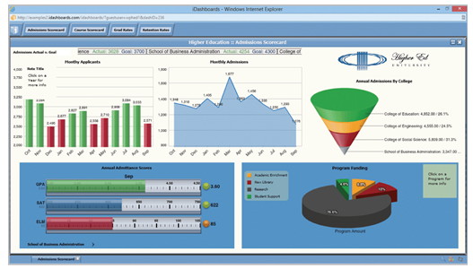
Operational and Analytical Databases (6 of 8)

Slide 11
Operational and Analytical Databases (7 of 8)
Analytical databases perform the following:
  Find relationships and patterns using data mining
  Make predictions using predictive analytics
  Examine multiple factors using OLAP (online analytical processing)

Slide 12

Operational and Analytical Databases (8 of 8)

Slide 13
Database Models (1 of 13)
The underlying structure of a database is referred to as a database model
One of the simplest models for storing data is a flat file that consists of a single, two-dimensional table of data elements
Spreadsheets are stored as flat files displayed as rows and columns

Slide 14
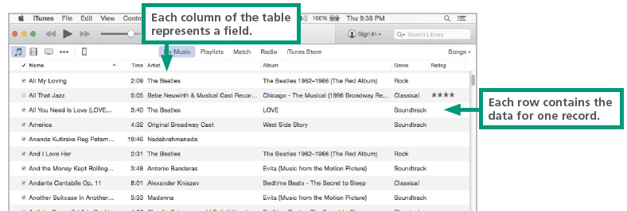
Database Models (2 of 13)

Slide 15
Database Models (3 of 13)
A field contains the smallest unit of meaningful information; it is the basic building block for a structured file or database
A variable-length field is like an accordion—it expands to fit the data you enter
A fixed-length field contains a predetermined number of characters (bytes)
In the world of databases, a record refers to a collection of data fields; the template for a record is a record type

Slide 16
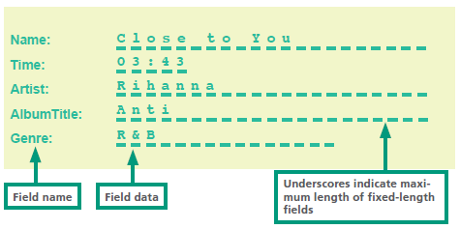
Database Models (4 of 13)

Slide 17
Database Models (5 of 13)
In database jargon, a relationship is an association between data that’s sorted in different record types
An important aspect of the relationship between record types is cardinality, which refers to the number of associations that can exist between two record types
The relationship between record types can be depicted graphically with an entity-relationship diagram (sometimes called an ER diagram or ERD)

Slide 18
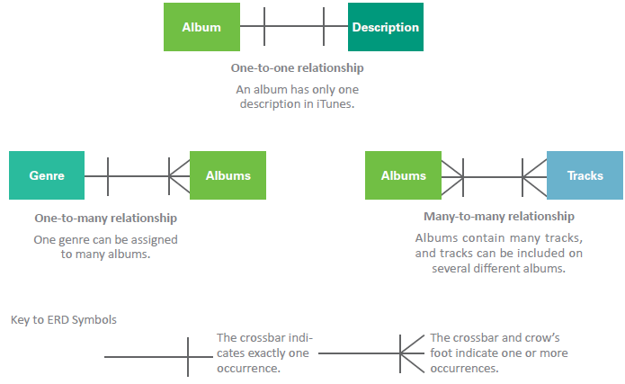
Database Models (6 of 13)

Slide 19
Database Models (7 of 13)
Many database models keep track of relationships among data, but there are different techniques for doing so
A hierarchical database allows one-to-one and one-to-many relationships that are linked in a hierarchical structure

Slide 20
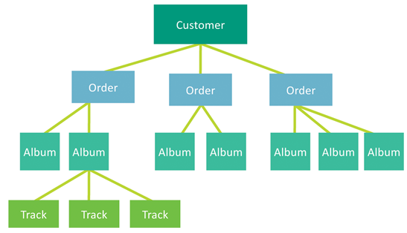
Database Models (8 of 13)

Slide 21
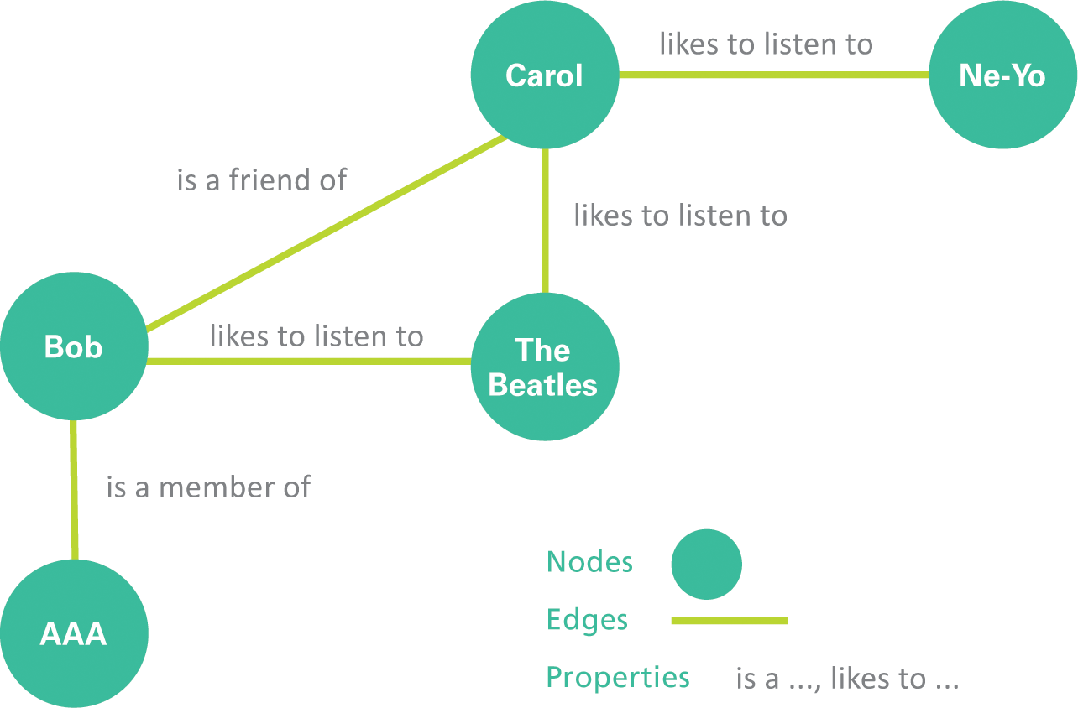
Database Models (9 of 13)
A graph database offers an alternative way to track relationships; its structure resembles sociograms with their interlinked nodes

Slide 22
Database Models (10 of 13)
A relational database stores data in a collection of related tables
Each table is a sequence of records, similar to a flat file
A multidimensional database organizes relationships over three or more dimensions; in the context of databases, a dimension is a layer based on a data element, such as a product, place, or customer, that can be used to categorize data

Slide 23
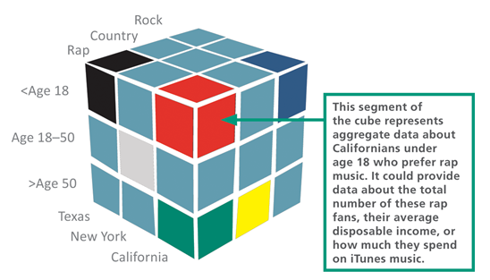
Database Models (11 of 13)

Slide 24
Database Models (12 of 13)
An object database, also called an object-oriented database, stores data as objects, which can be grouped into classes and defined by attributes and methods
Object databases excel at representing objects that have slightly different attributes, which is the case in many real-world business applications
A document-oriented database stores unstructured data, such as the text of a speech
XML (eXtensible Markup Language) is a popular tool used to format document databases

Slide 25
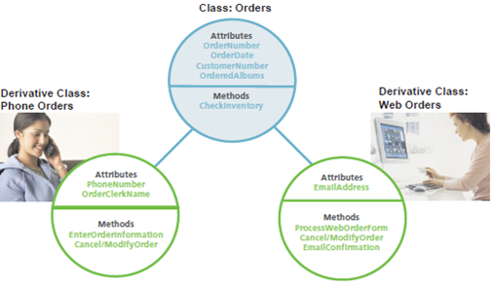
Database Models (13 of 13)
An object database can easily store data about different types of orders. A class called Orders holds data and methods common to all types of orders. A derivative class called Phone Orders inherits all the characteristics of Orders, but it has attributes and methods unique to orders placed by telephone. Web Orders is a derivative class that has attributes and methods unique to orders placed over the Web.

Slide 26
Section B: Database Tools
Database Tool Basics
Dedicated Applications
Word Processor Data Tools
Spreadsheet Data Tools
Database Management Systems

Slide 27
Section B: Objectives (1 of 2)
Explain why database designers try to avoid data dependence
Provide examples of at least five dedicated applications that are based on databases
Describe the data management features available in word processors
Provide three examples of the kinds of data you might successfully store and manipulate with spreadsheet software

Slide 28
Section B: Objectives (2 of 2)
Name two DBMSs that are relatively easy to use, and list four companies that produce an enterprise-level DBMS
Explain how the concept of serializability relates to databases
Describe the three categories of database clients
List at least four security measures that are important for database management

Slide 29
Database Tool Basics (1 of 2)
Data dependence is a term that refers to data and program modules being so tightly interrelated that they become difficult to modify
Modern database tools support data independence, which entails separating data from the programs that manipulate data

Slide 30
Database Tool Basics (2 of 2)
TOOL | COST | VERSATILITY | EASE OF USE
Dedicated software, such as an address book | Shareware available for simple applications is inexpensive; dedicated software for business applications can be costly, | Normally, the software is dedicated to a single type of database. | Easy; minimal setup is required because fields are predefined.
Word processing software | Most consumers have word processing software. | The software is best for simple flat files, such as mailing lists. | Easy; the software uses an interface familiar to most users.
Spreadsheet software | Most consumers have spreadsheet software. | The software is best for simple flat files that involve calculations. | Easy; the software uses an interface familiar to most users.
Database software | Basic shareware database software is inexpensive; high-end database software can be expensive. | High-end packages provide excellent versatility. | High-end database software often has a steep learning curve.

Slide 31
Dedicated Applications (1 of 3)
The simplest tools for managing data are dedicated applications for specific data management tasks, such as keeping track of appointments or maintaining an address book
To use one of these tools, simply enter your data. The software includes menus that allow you to manipulate your data once it is entered
Dedicated applications are easy to use; however, they generally don’t allow users to add fields or change field names

Slide 32
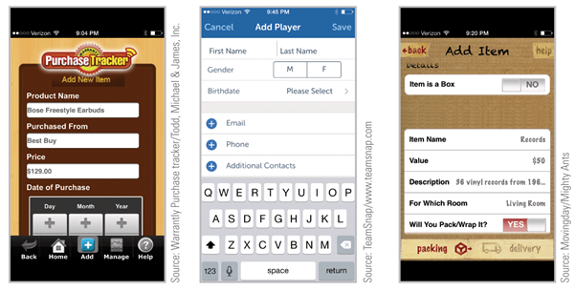
Dedicated Applications (2 of 3)

Slide 33
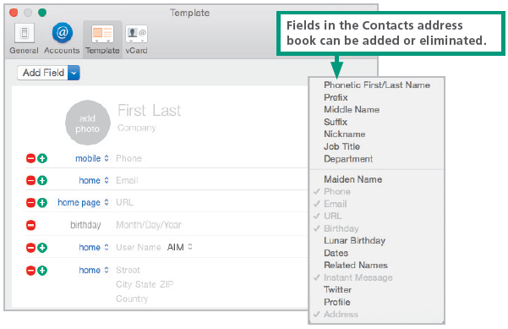
Dedicated Applications (3 of 3)

Slide 34
Word Processor Data Tools (1 of 2)
Word processing software is designed to produce documents, but it also may include tools for working with unstructured or structured data
Most word processing software includes a sort feature that can be used to arrange a simple list in alphabetical or numeric order
A single-level sort uses only one field to arrange records
A multi-level sort arranges information by more than one field

Slide 35
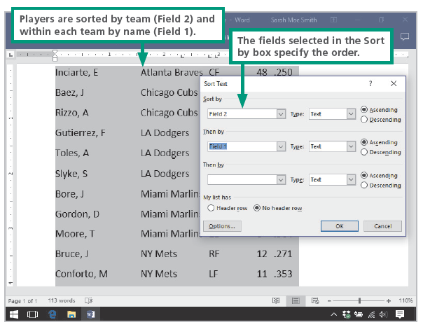
Word Processor Data Tools (2 of 2)

Slide 36
Spreadsheet Data Tools (1 of 2)
Spreadsheets are organized in table format, so it makes sense that they can be used for sorting data
Depending on the spreadsheet software, it may be possible to sort records, validate data, search for records, perform simple statistical functions, and generate graphs based on the data

Slide 37
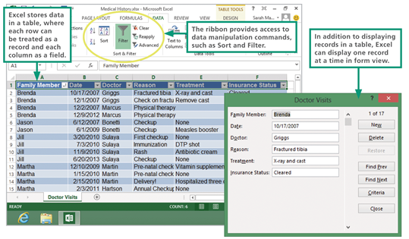
Spreadsheet Data Tools (2 of 2)

Slide 38
Database Management Systems (1 of 4)
When a word processor or spreadsheet isn’t sufficient to handle a data set, a DBMS is an option that offers a set of development tools for creating and accessing databases
The term DBMS (database management system) refers to software that manages data stored in a database
Filemaker Pro and Microsoft Access are easy-to-use DBMSs that are a good fit for small businesses and individuals

Slide 39
Database Management Systems (2 of 4)
Modern DBMSs work with many kinds of data including text, numbers, images, PDFs, and audio files
Today, databases might reside on a in-house server, or on a cloud-based server, or on distributed servers scattered throughout the world
DBMSs handle the details of how to most efficiently arrange data on a storage medium for optimal access speed
DBMSs require security features to ensure data confidentiality, protect against insider threats, and block unauthorized access

Slide 40
Database Management Systems (3 of 4)
Prevention
User rights management
  Allows access to data on an asneeded basis
Encryption
  Scrambles data that resides in storage, so that it is useless to thieves who acquire stolen devices containing databases
Database assessment
  Identifies sensitive data and database vulnerabilities in order to secure them

Slide 41
Database Management Systems (4 of 4)
Redaction
  Masks confidential data such as credit card numbers
Intermediary servers
  Prevent users from directly accessing the database, but instead allow users access only to a query processor

Slide 42
Section C: Database Design
Defining Fields
Data Types
Normalization
Sorting and Indexing
Designing the Interface
Designing Report Templates

Slide 43
Section C: Objectives
Explain how computed fields save storage space
List three common data entry errors and the strategies that database designers use to reduce the number of them
List eight data types and provide a real-world example for each one
Explain why database designers normalize a database and how they do it
Distinguish the difference between a sort and an index
List at least three best principles for designing database interfaces
Explain the purpose of a report template

Slide 44
Defining Fields (1 of 2)
There are three core elements in a relational database: fields, tables, and relationships
The term database structure refers to the arrangement of fields, tables, and relationships in a database
The first step in structuring a relational database is to determine what data should be collected and stored
A computed field is a calculation that a DBMS performs, similar to the way a spreadsheet computes a formula
A field format is a template that adds the correct formatting as data is entered

Slide 45
Defining Fields (2 of 2)
A field validation rule is a specification that the database designer sets up to filter data entered into a particular field
A lookup routine validates a field entry by checking data in an in-house or third-party database

Slide 46
Data Types (1 of 2)
The data that can be entered into a field depends on the field’s data type
A data type specifies the way data is represented on physical storage media and RAM
Data types:
  Real – used for fields that contain numbers with decimal places
  Integer – used for fields that contain whole numbers
  Date – stores dates in a format that allows them to be manipulated

Slide 47
Data Types (2 of 2)
  Text – assigned to fixed-length fields that hold character data
  Memo – provides a variable-length field for user comments
  Logical (Boolean) – used for true/false and yes/no data
  BLOB (binary language object) – can be any type of data
  Hyperlink – stores URLs used to link from a database to a Web page

Slide 48
Normalization
A process called normalization helps database designers create a database structure that minimizes storage space and increases processing efficiency
The goal of normalization is to minimize data redundancy—the amount of data that is duplicated in a database

Slide 49
Sorting and Indexing
A table’s physical sort order is the order in which data is arranged on storage devices
A sort key is the column of data that is used as the basis for rearranging the data
Sorted tables produce faster queries and updates using clever algorithms to find data
A database index contains a list of keys, and each key provides a pointer to the data that contains the rest of the fields related to that key

Slide 50
Designing the Interface (1 of 3)
The following guidelines list strategies for producing well-designed database interfaces:
Arrange fields in a logical order beginning at the upper-left corner of the screen. The first fields should be those used most often or those that come first in the data entry sequence
Provide visual clues to the entry areas. A box, a line, or shading can delineate data entry areas
Entry areas should appear in a consistent position relative to their labels
By convention, labels are placed to the left of the entry areas or above them

Slide 51
Designing the Interface (2 of 3)
Provide a quick way to move through the fields in order. By convention, the Tab key performs this function on desktop and laptop computers
If all fields do not fit on a single screen, use scrolling or create a second screen
Provide buttons or other easy-to-use controls for moving from one record to another
Stay aware of the platform; controls for a touchscreen device have to be large, well spaced, and easy to operate
Supply on-screen instructions to help ensure that data is entered correctly. Web databases can benefit from links to help pages

Slide 52
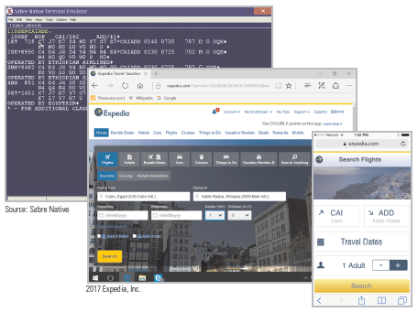
Designing the Interface (3 of 3)

Slide 53
Designing Report Templates
A report is a printed or screen-based list of some or all of the data in a database
Most DBMSs include a report generator, which is a software tool for specifying the content and format for a database report
A report template contains the outline or general specifications for a report

Slide 54
Section D: SQL
SQL Basics
Adding Records
Searching for Information
Updating Fields
Joining Tables

Slide 55
Section D: Objectives
Explain how SQL relates to databases
Describe how SQL injection works
List at least five SQL command words and describe what they do
Describe how to use Boolean operators in a query and provide examples
Provide an example in which a global update is used efficiently
Illustrate how SQL can be used to join two tables using dot notation

Slide 56
SQL Basics (1 of 3)
Commands processed by the DBMS are issued using computer programming languages designed for databases
These languages are sometimes called query languages because one of their main capabilities is to request data from a database
The database client software collects input from the user and then converts it into an SQL query, which can operate directly on the database to carry out the user’s instructions

Slide 57
SQL Basics (2 of 3)
The SQL query language provides a collection of special command words called SQL keywords, such as SELECT, FROM, INSERT, and WHERE
Most SQL queries can be divided into three simple elements that specify an action, the name of a database table, and a set of parameters
An SQL query begins with an action keyword, or command, which specifies the operation you want carried out
Parameters are detailed specifications for a command

Slide 58
SQL Basics (3 of 3)
COMMAND | DESCRIPTION | EXAMPLE
CREATE | Create a database or table. | CREATE TABLE Albums
DELETE | Remove a record from a table. | DELETE FROM Tracks WHERE TrackTitle = 'Blue Suede Shoes'
INSERT | Add a record. | INSERT INTO AlbumDescription (Cat#, Condition) VALUES ('LPM-2256', 'Mint condition; no visible scratches; original album cover')
JOIN | Use the data from two tables. | SELECT FROM Albums JOIN Tracks ON Albums.Cat# = Tracks.Cat#
SELECT | Search for records. | SELECT FROM Albums WHERE Artist = 'Beatles'
UPDATE | Change data in a field. | UPDATE Albums SET Price = 15.95 WHERE Cat# = 'LPM-2256'

Slide 59
Adding Records
A database record contains information about an entity, such as a customer, an online purchase, an ATM withdrawal, or a social media post
The data is bundled into an SQL statement that is handled by the DBMS
Using the INSERT command, a user can add data to a record

Slide 60
Searching for Information
One of the most common database operations is to query for particular record or a group of records by using the SELECT command
The database client software uses a search specification to create the SQL query; a result is generated for this query
SQL uses Boolean operators such as AND, OR, and NOT to form complex queries

Slide 61
Updating Fields
Updates and modifications to the contents of a database field are made by using the SQL UPDATE command
The UPDATE function works only for records that have similar characteristics
Custom programming is required to perform global operations on information that does not have any similar characteristics

Slide 62
Joining Tables
In SQL terminology, creating a relationship between tables is referred to as joining tables
The SQL JOIN command allows users to temporarily join and simultaneously access the data in more than one table
When joining two tables, the convention is to use dot notation for field names; SQL uses dot notation to make distinctions between data

Slide 63
Section E: Big Data
Big Data Basics
Big Data Analytics
NoSQL

Slide 64
Section E: Objectives (1 of 2)
List the elements that define the 3rd platform of computing
List the five Vs that characterize big data
Describe at least three examples of datasets that would be considered big data
List the four characteristics of NoSQL
Explain the difference between scaling up and scaling out
Explain how dynamic scaling works and how it relates to big data

Slide 65
Section E: Objectives (2 of 2)
Support or refute the statement that NoSQL tools are schema-less
Describe and diagram an example of a key-value data model
Demonstrate the different retrieval strategies for data stored in a relational database and data stored in a column-oriented database
Give at least three examples of large datasets that would be best handled by a graph schema
Describe Hadoop and MapReduce

Slide 66
Big Data Basics (1 of 2)
Big data refers to the huge collections of data that are difficult to process, analyze, and manage using conventional database tools
An example of big data is the 1 million transactions generated by Walmart sales registers every hour
Big data is a relatively new phenomenon that businesses are just beginning to deal with

Slide 67
Big Data Basics (2 of 2)
Big data is characterized as having:
  High volume
  High velocity
  Diversified variety
  Unknown veracity
  Low-density value (low-density data refers to large volumes of data containing unimportant details)

Slide 68
Big Data Analytics (1 of 3)
Mainstream big data exploration produces commercial benefits
A high percentage of today’s expenditures on big data are for technologies that enhance the customer experience and provide targeted marketing solutions
Real-time analysis and decision making are popular reasons to invest in big data technologies

Slide 69
Big Data Analytics (2 of 3)
Government
  Threat prediction
  Cybersecurity
  Compliance and regulatory analysis
Retail
  Shopper behavior analysis
  Loyalty program management
  Supply chain optimization

Slide 70
Big Data Analytics (3 of 3)
Health care
  Track infectious diseases
  Genetic analysis
  Design proactive care plans
Communications
  Retain customers
  Call record analysis
  Infrastructure optimization

Slide 71
NoSQL (1 of 6)
The term NoSQL is used to refer to a group of technologies for managing databases that do not adhere to the relational model and standard SQL query language
NoSQL technologies are effective for building and managing non-relational databases containing big data that may be unstructured and may be distributed across multiple servers

Slide 72
NoSQL (2 of 6)
Distributed
  Handles data that is stored across many devices
Dynamically scaling
  Easy to add storage devices as the database grows or as the velocity of incoming data accelerates
Flexible data
  Handles a variety of data types, as well as data that is structured, semi-structured, and unstructured
Non-relational
  Uses data models other than the standard relational models and SQL

Slide 73
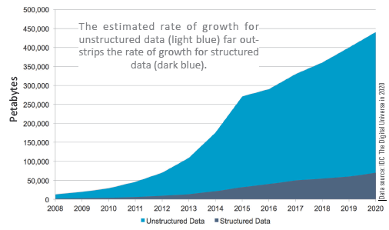
NoSQL (3 of 6)

Slide 74
NoSQL (4 of 6)
Unstructured and semi-structured data—such as tweets, email messages, blog posts, and videos—are difficult to mold into fixed structures
Relational databases are organized according to a schema, which is a blueprint for its structure; rows, columns, and tables of a database are part of its schema
NoSQL tools create schema-less databases, allowing data structures such as fields to be added

Slide 75
NoSQL (5 of 6)
The simplest structure for storing data in a NoSQL database is the key-value data model; each data item has a key that is a unique identifier similar to a relational database key such as CustomerID
The column-oriented data model stores data in columns, rather than in rows, so it works well in situations where the focus is on analysis of chunks of data

Slide 76
NoSQL (6 of 6)
Popular NoSQL tools include:
  MongoDB
  Cassandra
  Hbase
  Hive
  Presto
  Google BigTable
  Spark
  Voldemort
The two most popular are Hadoop and MapReduce

